Slide 1
Chapter 2 Objectives
The CCNA Topics Covered in this chapter include:
  Internetworking Basics
  Layered Models
  The OSI Model
  Ethernet Networking
  Data Encapsulation
  Cisco’s Three-Layer Model
  Chapter 1 Written Labs and Review Questions

Slide 2
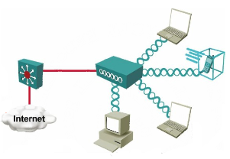
Wireless LAN (WLAN)
A WLAN is a shared network.
An access point is a shared device and functions like a shared Ethernet hub.
Data is transmitted over radio waves.
Two-way radio communications (half-duplex) are used.
To arbitrate the use of the frequency, WLANs use the CSMA/CA (Carrier Sense Multiple Access with Collision Avoidance) algorithm to enforce HDX logic and
avoid as many collisions as possible.
The same radio frequency is used for sending and receiving (transceiver).

Slide 3
What are WLANs?
They are:
Local
In building or campus for mobile users
Radio or infrared
Not required to have RF licenses in most countries
Using equipment owned by customers
They are not:
WAN or MAN networks
Cellular phone networks
2.5 G or 3G services or GPRS

Slide 4
Similarities between WLAN and LAN
A WAN is an 802 LAN.
- The IEEE defines standards for both using the 802.3 family for Ethernet LANs and the 802.11 family for WLANs.
- Transmits the data over air vs data over the wire.
- Looks like a wired network to the user.
- Defines physical and data link layer.
- Both define a frame format with a header and trailer, with the header including a source and destination MAC address field, each 6 bytes in length.
- Both define rules about how the devices should determine when they should send frames and when they shouldn’t.
The same protocols/applications run over both WLANs and LANs.
- IP (network layer)
- IPSec-VPNs (IP based)
- Web, FTP, SNMP (applications)

Slide 5
Differences between WLAN and LAN
Wireless LANs use radio waves as the physical layer.
- WLANs use CSMA/CA instead of CSMA/CD to access the network.
Radio waves have the problems that are not found on wires.
- Connectivity issues.
    Coverage problems
    Multipath issues
    Interference, noise
- Privacy issues
WLANs use mobile clients.
- No physical connection.
- Battery powered.
WLANs must meet country specific RF regulations.

Slide 6
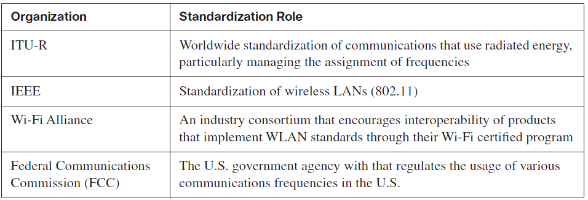
Wireless LAN Standard
Organizations that set or influence WLAN Standards

Slide 7
802.11 Standards
Here are the most popular standards in use today:
802.11b: 2.4Ghz, maximum bandwidth of 11Mbps
802.1g: 2.4Ghz, up to 54Mbps
802.11a: 5Ghz, up to 54Mbps

Slide 8
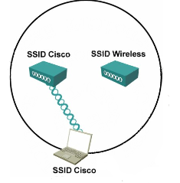
Service Set Identifier (SSID)
The SSID is the name of wireless cell.
SSID is used to logically separate WLANs.
The SSID must match on client and access point.
Access points broadcasts one SSID in beacon.
Therefore clients can be configured without SSID.
Clients association steps :
- Client sends probe request
- Access point sends probe response
- Client initiates association
- Access point accepts association
- Access point adds client MAC address to association table

Slide 9
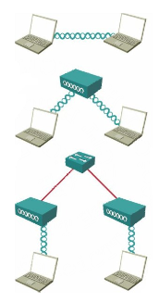
Service Sets & Modes
Ad hoc mode:
Independent Basic Service Set (IBSS):
- Mobile clients connect directly without
an intermediate access point.
Infrastructure mode:
Basic Service Set (BSS):
- Mobile clients use a single access point for
connecting to each other or to wired network resources.
Extended Service Set (ESS):
- Two or more basic service sets are connected by
a common distribution system (DS).

Slide 10
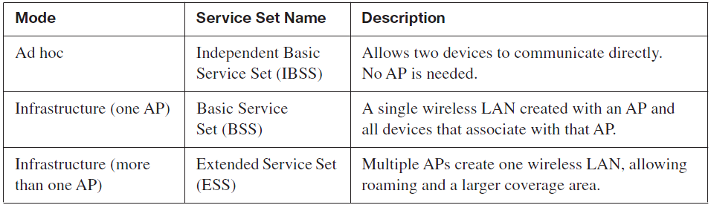
Different WLAN Modes & Names

Slide 11
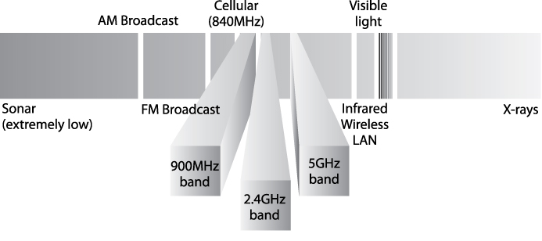
Wireless Transmissions (Layer 1)
WLANs transmit data at layer 1 by sending and receiving radio waves.

Slide 12
Wireless Transmissions (Layer 1)
Three Classes of Encoding:
1. Frequency Hopping Spread Spectrum (FHSS):
- Uses all frequencies in the band, hopping to different ones.
- By using slightly different frequencies for consecutive
transmissions, a device can hopefully avoid interference
from other devices that use the same unlicensed band,
succeeding at sending data at some frequencies.
- The original 802.11 WLAN standards used FHSS, but the
current standards (802.11a, 802.11b, & 802.11g) do not.

Slide 13
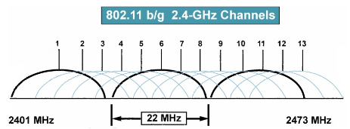
Wireless Transmissions (Layer 1)
2. Direct Sequence Spread Spectrum (DSSS):
- Followed as the next general class of encoding type for WLANs.
- Designed for use in the 2.4 GHz unlicensed band.
- Uses one of several separate channels or frequencies.
- This band has a bandwidth of 82 MHz, with a range from 2.402 GHz
to 2.483 GHz. This band can have 11 (North America) or 13 (Europe)
different overlapping DSSS channels.

Slide 14
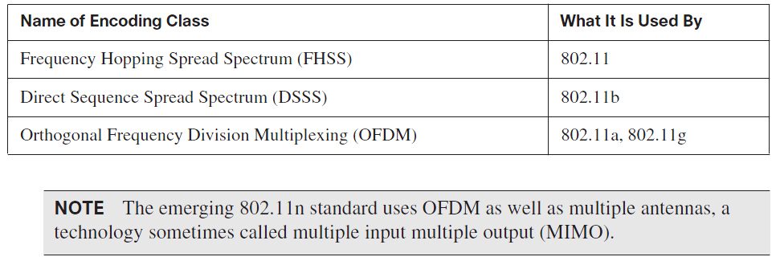
Wireless Transmissions (Layer 1)
3. Orthogonal Frequency Division Multiplexing (OFDM):
Like DSSS, WLANs that use OFDM can use multiple
non overlapping channels.

Slide 15
Wireless Transmissions (Layer 1)
The key measurement for interference is the
Signal-to-Noise Ratio (SNR). This calculation measures
The WLAN signal as compared to the other undesired
signals (noise) in the same space. The higher the SNR,
the better the WLAN devices can send data successfully.

